Slide 1
Customer churn analysis
Telecom industry

Slide 2
Activities done using Excel
Avg monthly long distance charges , Multiple lines , Internet Type, Avg monthly GB download, Online Security, Online Backup, Device Protection plan, Premium tech support, streaming tv,music,movies , unlimited data , Churn category, Churn Reason these columns have blanks or nulls
No Duplicates found in our data (using data>remove duplicates , or conditional formatting)
Assign text for all values or characters where calculations not required, zip codes always text as they might have zeros which might be ignored when used number format
Lati,long we set to number format for accuracy.
Treat spaces in column names _ as space is not taken in sql
Now count the blanks % for each column by using formula to understand if we want to drop columns
countA helps to count only non blanks where as rows helps to count all the rows in the dataset.
Used countblank/rows. Since we don’t have much of blank % we are not dropping any columns
Its all good and clean now to import into SQL we have total 7043 rows with data excluding column names
In excel avg monthly long distance charges, avg monthly gb download, we are replacing with 0 in place of nulls/blanks with formula. Using condition =if(B3=” “, 0 , B3)
We don’t have much of blank % so we don’t have to drop any column

Slide 3
Activities done using SQL
We use latitude as decimal(9,6) --→ which means total 9 digits and 6 digits after decimal,this gives exact data to locate geographies.
We are using alter table and then modify the columns to make changes to data type
Example: Alter table_name
Modify column_name data_type;
Load the data using table data import wizard, load data infile command etc..
Check the data types are accurate and the rows inserted
Check for Null and Blanks Values
We always set the safe mode to 0 to update or make changes to table
Impute the blanks with necessary values or text
We can make various analysis like top churn groups,by age, by gender
Now load the clean data back to load into power bi

Slide 4
Activities done on Power BI
Claculated measure on total customers
Churned Customers
Churned Rate
Select the various data categories for each column
Calculate the age groups using switch statement
Created Various Visuals
Drawn insights and later able to analyse recommendations

Slide 5
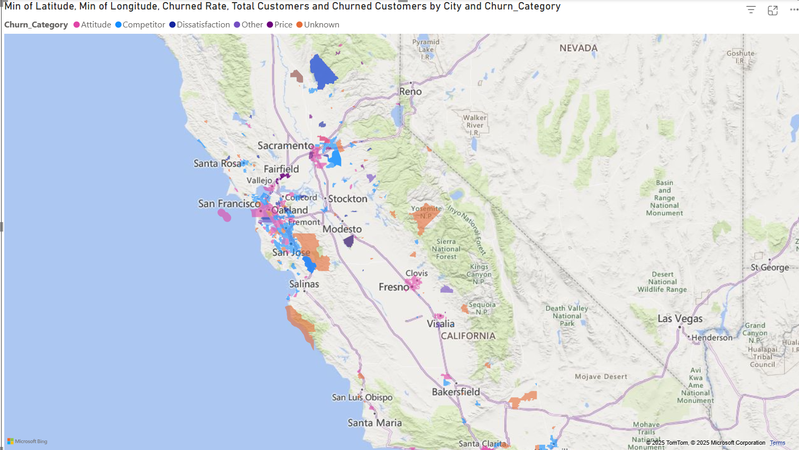

Slide 6
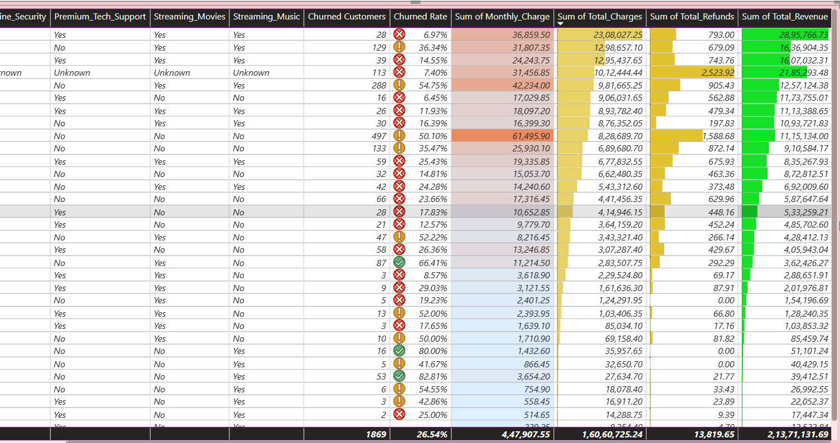

Slide 7
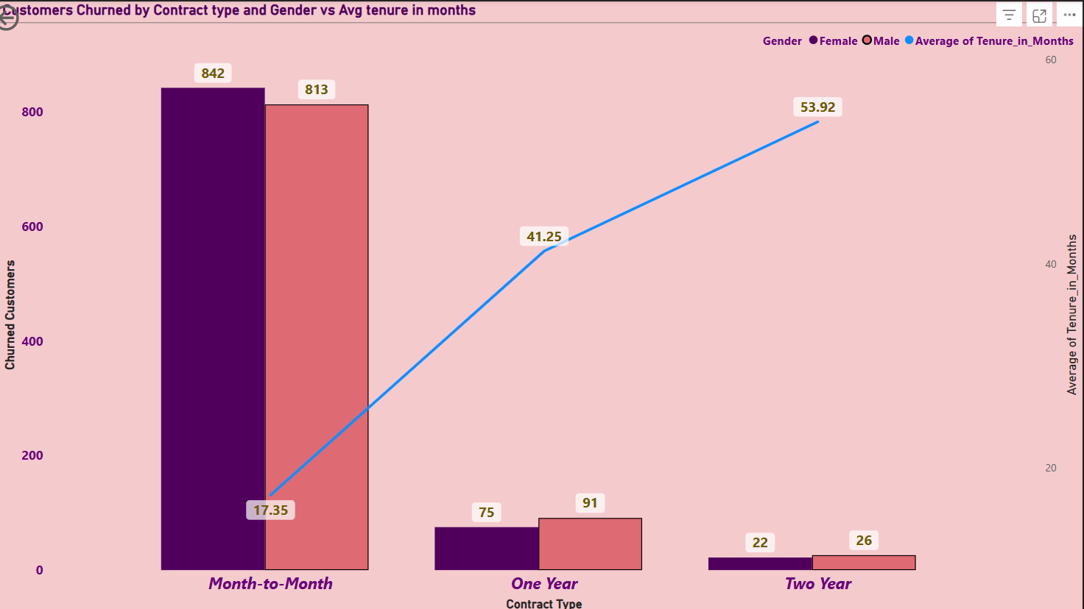

Slide 8
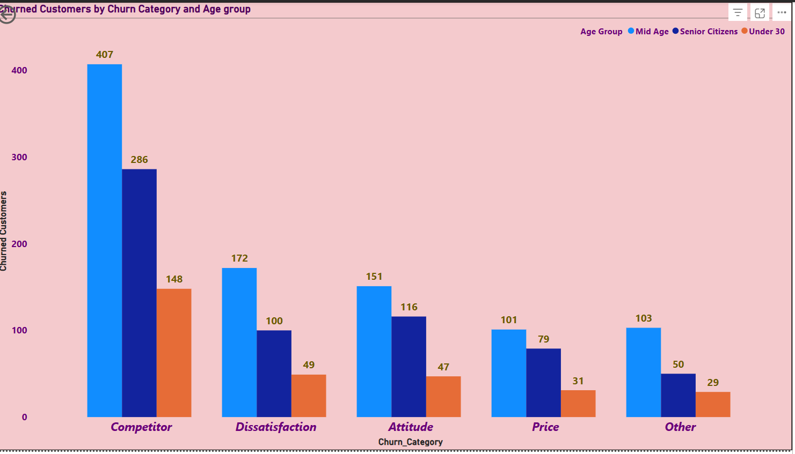

Slide 9
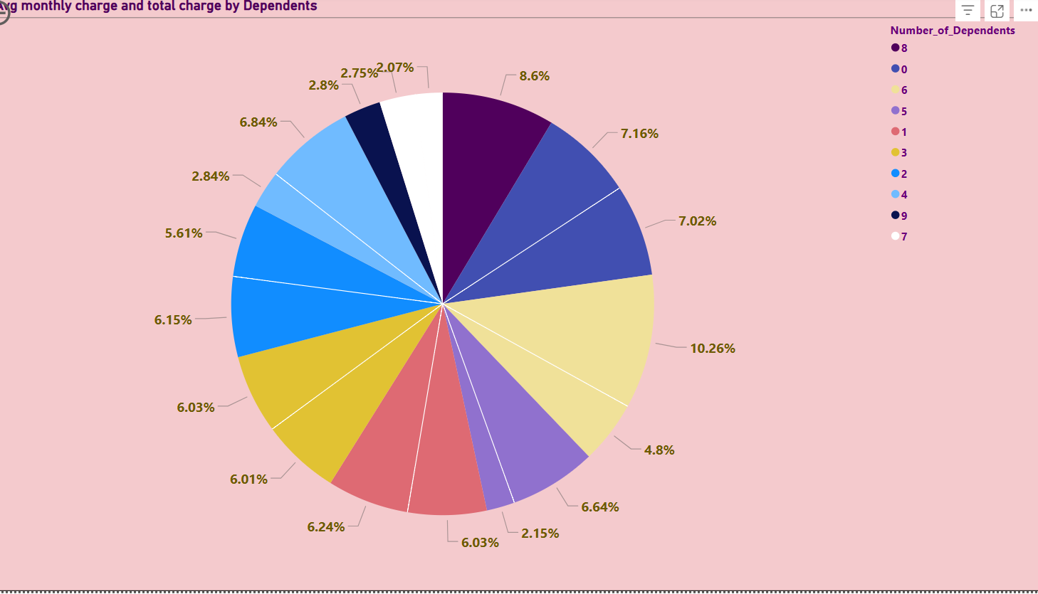

Slide 10
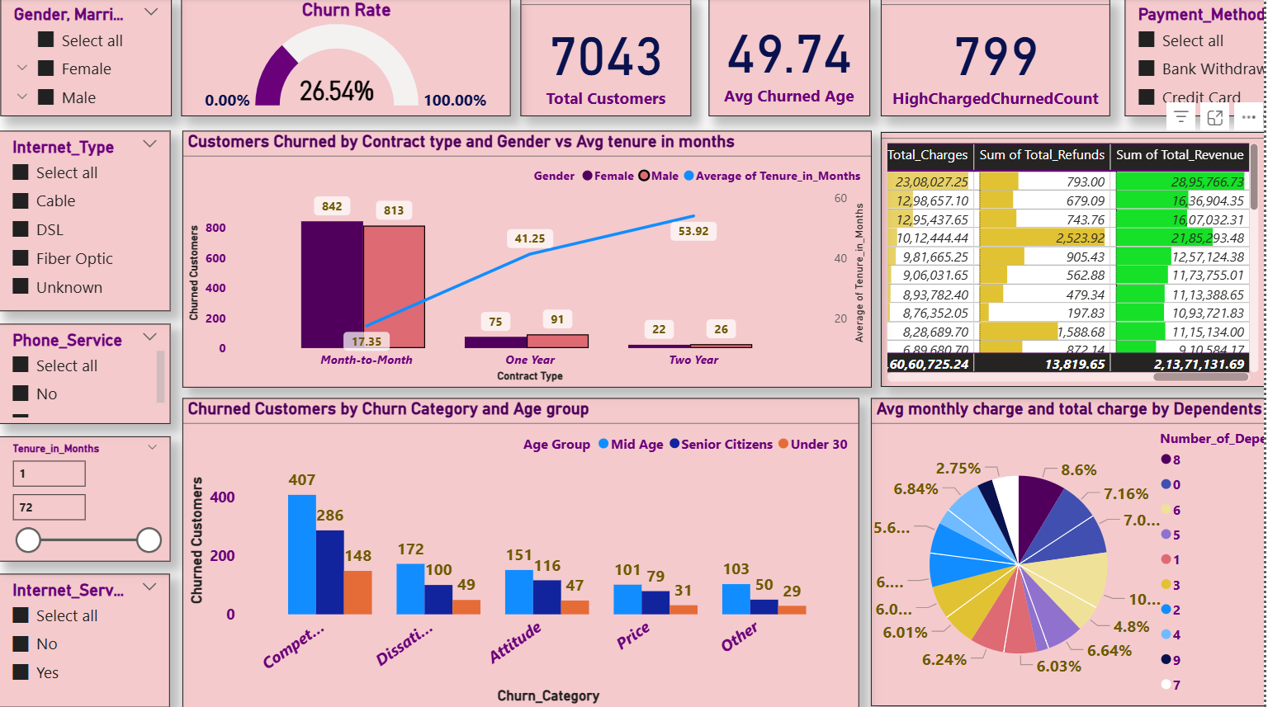

Slide 11
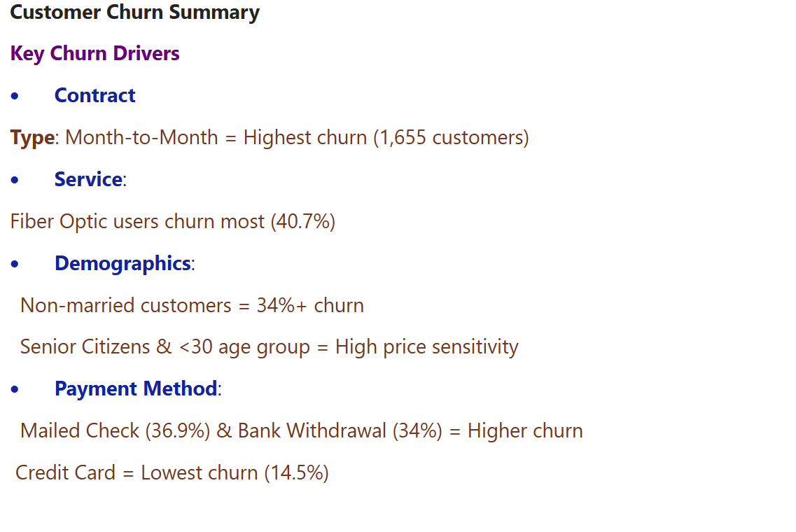

Slide 12
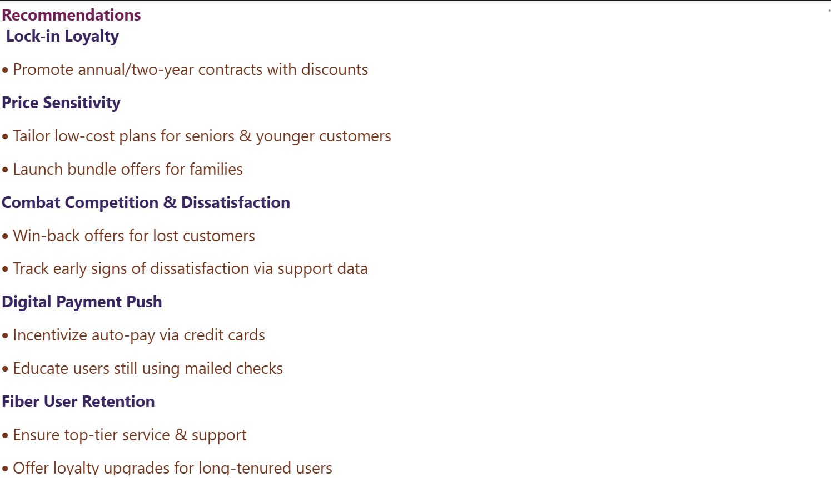

Slide 13
